Slide 1
Knuckles, The Robotic Arm
Andrew, Matthew, Rym, Paola
ECE 4335: ECE Systems Design

Slide 2
Overall Project
Knuckles
Assistive robotic arm that will hand the user requested objects and tools.
Services
Assistant that will increase the user’s productivity and decrease the risk of dexterity incidents.

Slide 3
Background Info. And Research
In today’s society, people are rushed and tend to multitask.
According to research from the scientific journal, Current Biology, shifting focus and attempting to multitask reduces productivity by around 40%.
SMF Mutual Insurance adds that multitasking can lead to dexterity incidents while performing hands-on work.

Slide 4
Issue & Solution
Problem: People tend to multi-task and have to worry about multiple actions at once.
This can lead to dexterity incidents, increasing time and sometimes costs in case of production or research contexts.
Needed: Avoid dexterity accidents. Knuckles provides a literal helping hand, flexibility; allowing a scientist to work without human assistance and still achieve results.
To reduce time searching for items, reduce injury, reduce wasted research time. Researcher can work on their own if no other scientist is available.
Notes:
Replace image with reflection image

Slide 5
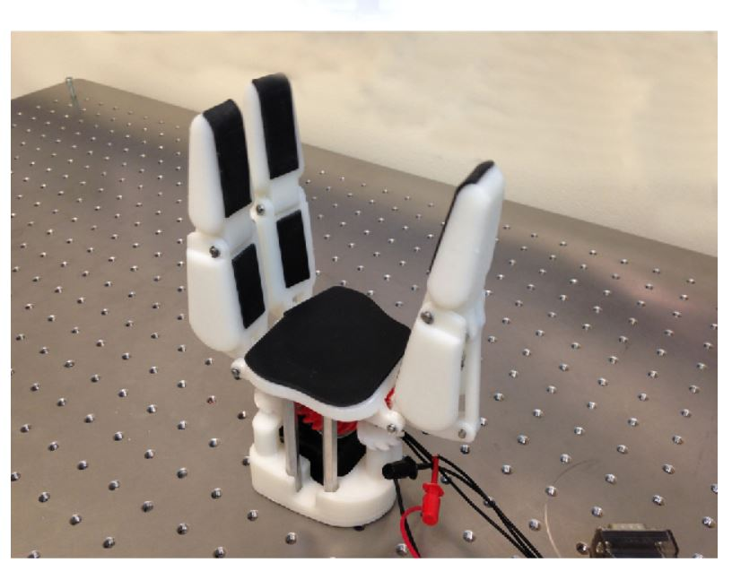
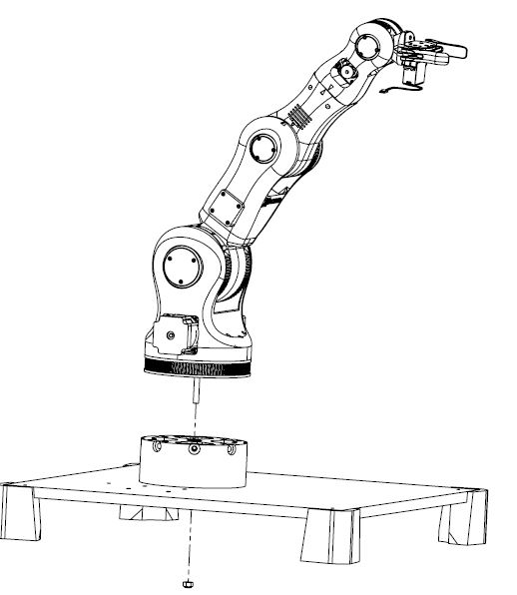
Meet Knuckles!
BCN3D Technologies – BCN3D Moveo (Spain)
Three-Finger Underactuated Adaptive (Kazakhstan/Australia)
Notes:
Replace image with reflection image

Slide 6
Deliverables
Fall 2018:
Hardware
Text commands
Object recognition
Simulation using Rviz on ROS
Spring 2019:
Software portion
Voice & Facial recognition
Testing & Demo
Fully functional robot
Notes:
Replace image with reflection image

Slide 7
User Analysis
Knuckles is currently being developed for lab researchers, mechanics and people with disabilities.
Knuckles can be used for residential purposes.
Users will not require much training, as Knuckles will be controlled through voice commands.
Knuckles will be in need of a power plug, computer, program to activate key words for voice commands.
Notes:
Replace image with reflection image

Slide 8
Significance
Convenience, productivity and cost effectiveness.
Anyone willing to use an extra hand would care about our project.
Technicians, people with disabilities, open-source robotics community, and researchers are all potential users.
The robotic arm will be best applied when the user is conducting hands-on work and is not able to get up from their work.
The user will not only save time and production costs but will also avoid injuries, as well as effectively find objects.
Notes:
Replace image with reflection image

Slide 9
Division of Labor
Andrew Blanchard -
Team captain, ROS, face recognition, hardware
Matthew van Zuilekom –
ROS, object recognition, hardware
Paola Hernandez –
ROS, object recognition, hardware
Rym Benchaabane –
ROS, voice recognition, hardware
Notes:
Replace image with reflection image

Slide 10
Project Conclusion
To summarize, multitasking can be impractical, sometimes dangerous, and time consuming.
Knuckles is a robotic arm that will assist the user with handing requested tools through voice commands to make the task more convenient and accomplish work goals more efficiently.

